Slide 1
Computer Architecture (CS-211)
Recitation 2
Song Wen

Slide 2


CS 211 Computer Architecture
TA Information
Name : Song Wen
Email : song.wen@rutgers.edu
If you need to send an e-mail, please use [CS-211] as prefix in your Email Subject!
Section 06 Recitation: Tuesday 9:00 AM - 9:55 AM Section 07 Recitation: Wednesday 9:00 PM - 9:55 PM
Office Hours : Tuesday 10:30 AM – 11:30 AM
https://rutgers.webex.com/meet/sw978
2

Slide 3
CS 211 Computer Architecture
Topics
Editors for C code
Use of Makefile and Compile C programs
Tar and Untar a file/directory
Programming Assignment 1
Data Structure
Dynamic Allocation
* Some materials are collected and compiled from previous year's CS 211 lectures and TAs
3

Slide 4
CS 211 Computer Architecture
Editors for C
Windows
- Notepad++
Linux/MAc
- Sublime, Geany, Emacs
- Vi, Vim, Nano
Windows SSH Client
- MobaXterm
4

Slide 5
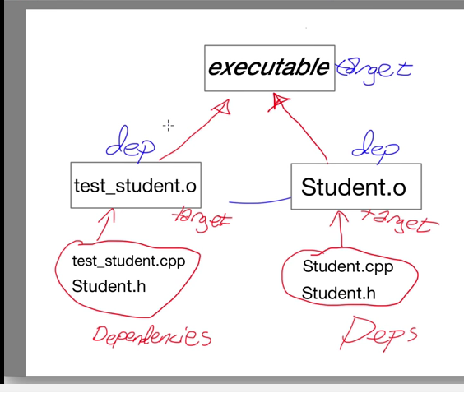
CS 211 Computer Architecture
How to Makefile!
Run a makefile
$ make
If you have several make files
$ make -f YourMakeFile
Clean a makefile
$ make clean
Basics of Makefile
target: dependencies
[tab] system command
Example
all:
gcc -Wall -Werror -fsanitize=address hello.c -o hello
clean:
rm –rf hello
5

Slide 6
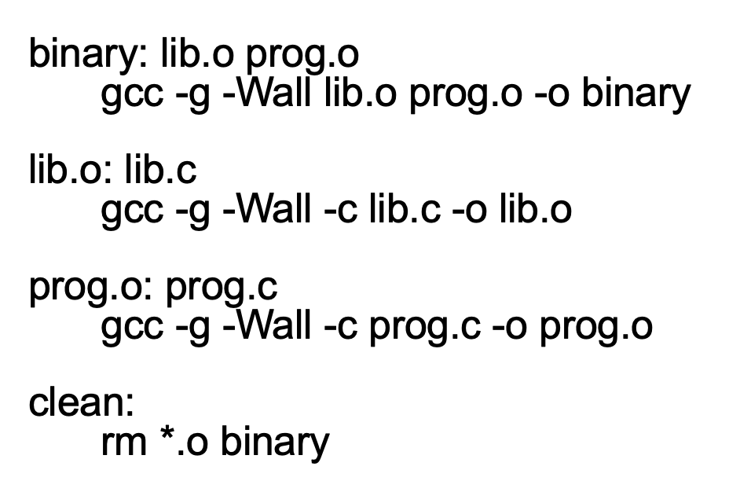
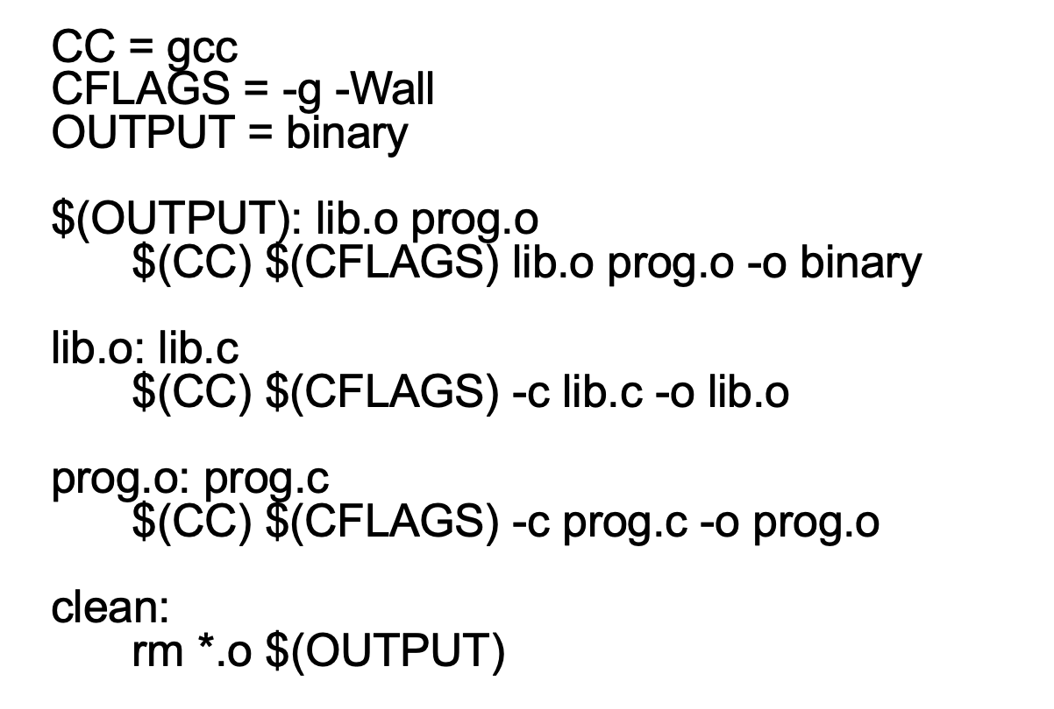
CS 211 Computer Architecture
How to Makefile!
target: dependency1 dependency2 ...
unix command (start line with TAB)
unix command
...
6

Slide 7
CS 211 Computer Architecture
Help on Makefile
Youtube : https://www.youtube.com/watch?v=kGGE8mtrbrM
Blog : http://mrbook.org/blog/tutorials/make/
Please remember the following tips:
Makefile has no file extension
Default name of the Makefile for any project is Makefile
TAB must be placed before each command written in Makefile
If you do not place TAB correctly in your Makefile, you may encounter errors.
You can check the TAB key in any editor.
- In Linux/Mac, open your Makefile in vim editor then press ESC then type "set list" and hit ENTER. It should show the TAB as "^I".
- In Windows, open your file using Notepad++ editor. Then go to View --> Show Symbol --> Show All Characters. In place of TAB, you should see "---
----->". If you don't see this characters in place of TAB, then you should correct your make file.
7

Slide 8
CS 211 Computer Architecture
Tar(tape archive)/Untar a File/Directory
How to tar:
Go to the parent directory of pa1
$ tar cvf pa1.tar(name of archive) pa1(directory)
Another example
$ tar cvf myfiles.tar dir1 dir2 file1 file2
How to check .tar
$ tar vtf target.tar
How to untar:
Go to the directory where you have .tar file
$ tar xvf pa1.tar
c: Create archive
v: Verbose i.e display progress while creating archive
f: Archive File name i.e the name of the archive file
x: means extract files from the archive
z : Compress archive using gzip program
8

Slide 9
CS 211 Computer Architecture
PA1 Directory structure
src
|- yell
|- Makefile
|- yell.c
|- rle
|- Makefile
|- rle.c
|- anagram
|- Makefile
|- anagram.c
|- list
|- Makefile
|- list.c
|- table
|- Makefile
|- table.c
src
|- mexp
|- Makefile
|- mexp.c
|- sudoku
|- Makefile
|- sudoku.c
|- bst
|- Makefile
|- bst.c
9

Slide 10
CS 211 Computer Architecture
Using the Autograder
Untar pa1_grader.tar
$ tar -xf pa1_grader.tar (will create pa1 directory)
Create src in pa1 directory
$ cd pa1
$ mkdir src
$ mkdir src/yell pa1
$ cp template.make src/yell/Makefile
Go to pa1 and run autograder
$ python grader.py
10

Slide 11
CS 211 Computer Architecture
PA1 Makefile and Archive
Makefile Example for bst
bst: bst.c
gcc -Wall -Werror -fsanitize=address -o bst bst.c
clean:
rm -f bst
How to tar and verify:
Tar your source file
$ tar cvf pa1.tar src
Check the list of the file
$ tar tf pa1.tar
11

Slide 12
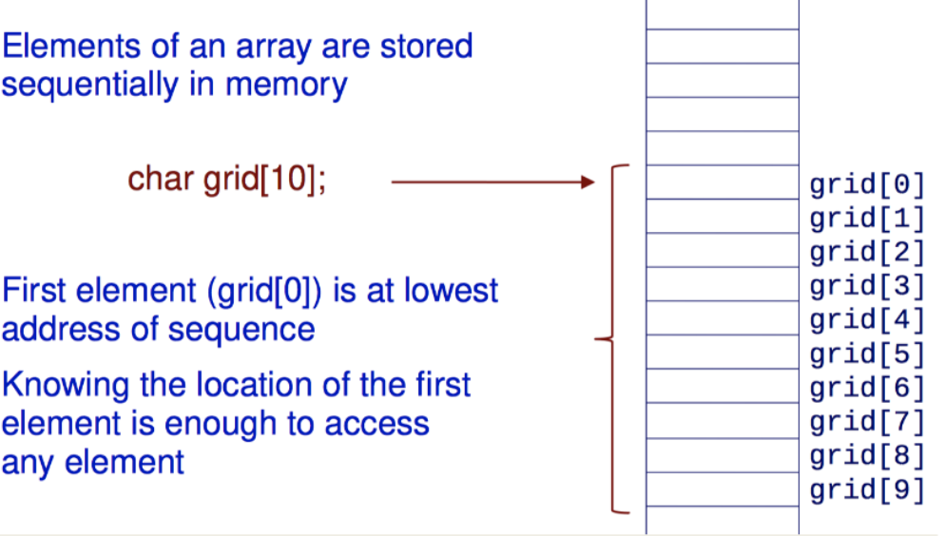
CS 211 Computer Architecture
Data Structures (Array)
Contiguous sequences of data items
same type: int a[9]
access by index: a[5]
start from zero: a[0]
Size must be determined at compile time
Marcos, SIZE, MAX_LEN …
An array name is essentially a pointer to the first element in the array.
12

Slide 13
CS 211 Computer Architecture
Data Structures (String)
Array of characters
char mystr_2[] = “hello, students!” (size can be calculated by compilers)
you can also indicate the size, if not used up, padding with ‘\0’
mystr_2[0] = ‘H’ (Yes, we can do that)
C string literals
char *mystr_3 = “hello, students!”
mystr_2[0] = ‘H’ (No, segmentation fault)
13

Slide 14
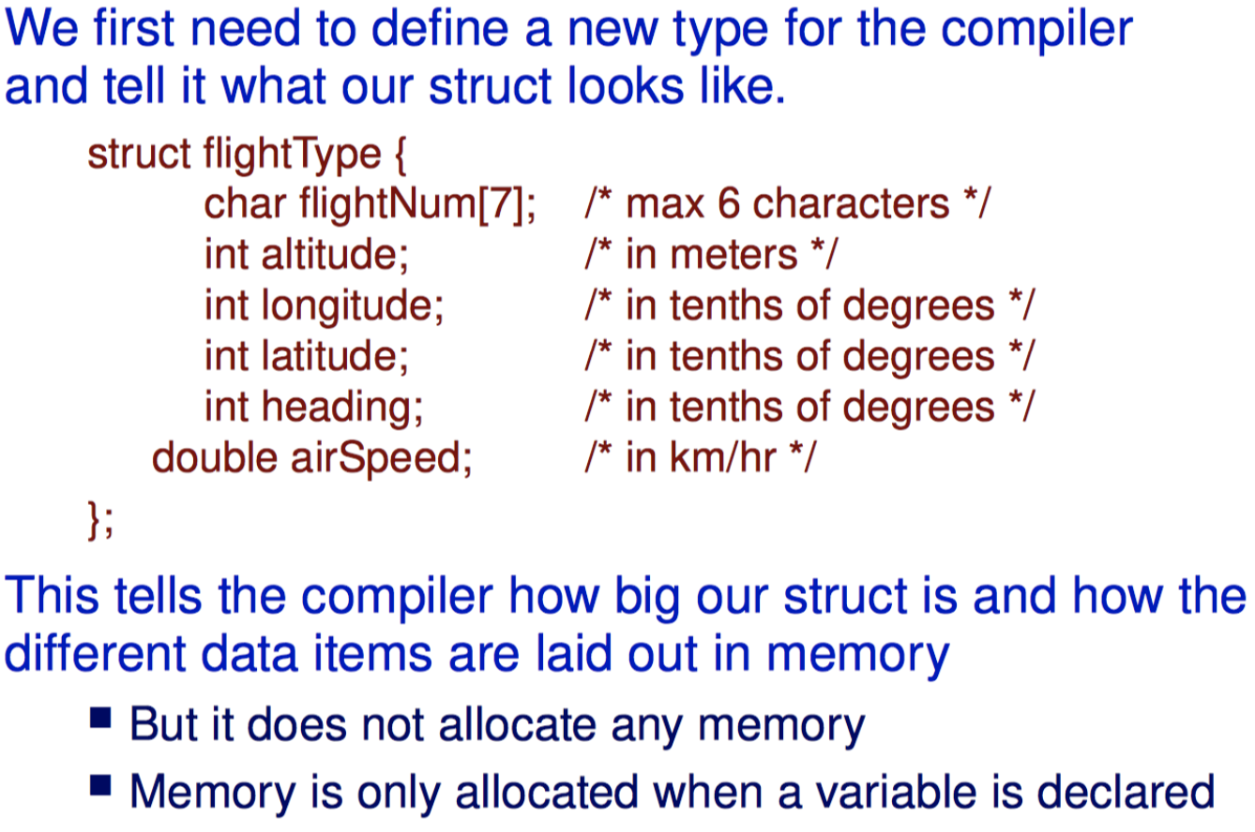
CS 211 Computer Architecture
Data Structures (Struct)
struct flightType flight1, flight2
typedef struct Node
{
int data;
struct Node * next;
}NODE;
14

Slide 15
CS 211 Computer Architecture
Data Structures (Struct)
struct flightType flight1, flight2
typedef struct Node
{
int data;
struct Node * next;
}NODE;
15

Slide 16
CS 211 Computer Architecture
Dynamic Allocation
Why do we need this?
We want to playing with variable numbers of items.
void *malloc(size_t number_of_bytes)
free() will reclaim the allocated memory
int *a
a = (int*)malloc(n*sizeof(int))
free(a)
16

Slide 17
CS 211 Computer Architecture
Q&A
Thanks!
17

